Slide 1
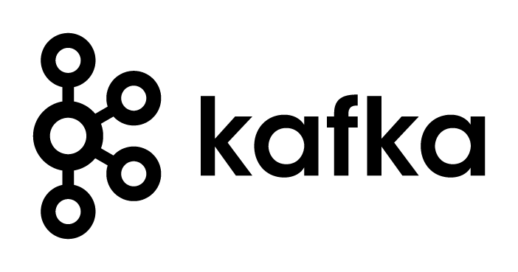
Apache Kafka
aakash
mohit

Slide 2
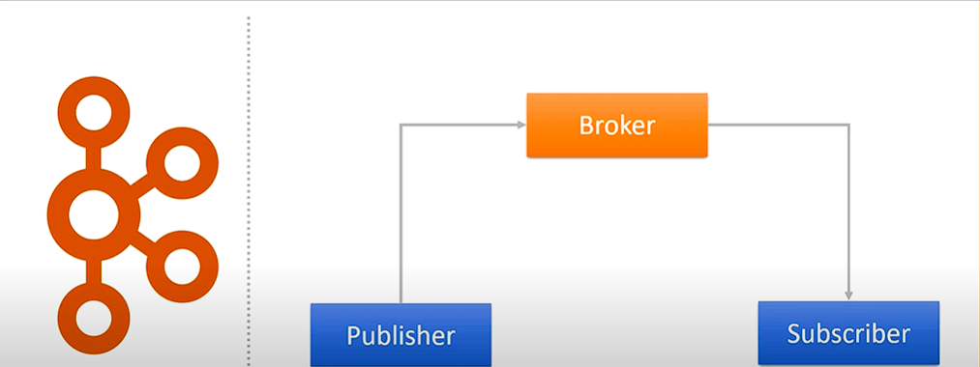
Asynchronous Messaging
In asynchronous messaging, the sender does not need to know anything about the receiver and vice-versa. Instead, the sender and the receiver need to know only which message format and which destination to use. The non-blocking nature of this communication allows recipients to only consume resources while active, which ultimately leads to less system overhead.

Slide 3
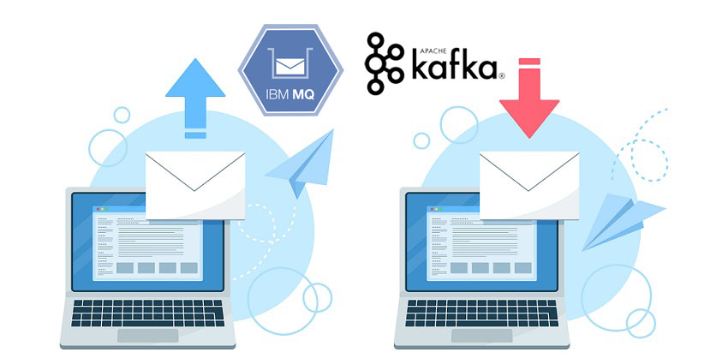
What tools are available to help achieve this?
There are many tools available to help you set up an asynchronous message-driven backbone for your reactive applications. The two main variations are Kafka and IBM MQ(Messaging Queue).

Slide 4
Apache Kafka
Apache Kafka is a distributed publish-subscribe messaging system that can handle a high volume of data and is designed to be fault-tolerant, scalable, high-throughput, and low-latency.

Slide 5
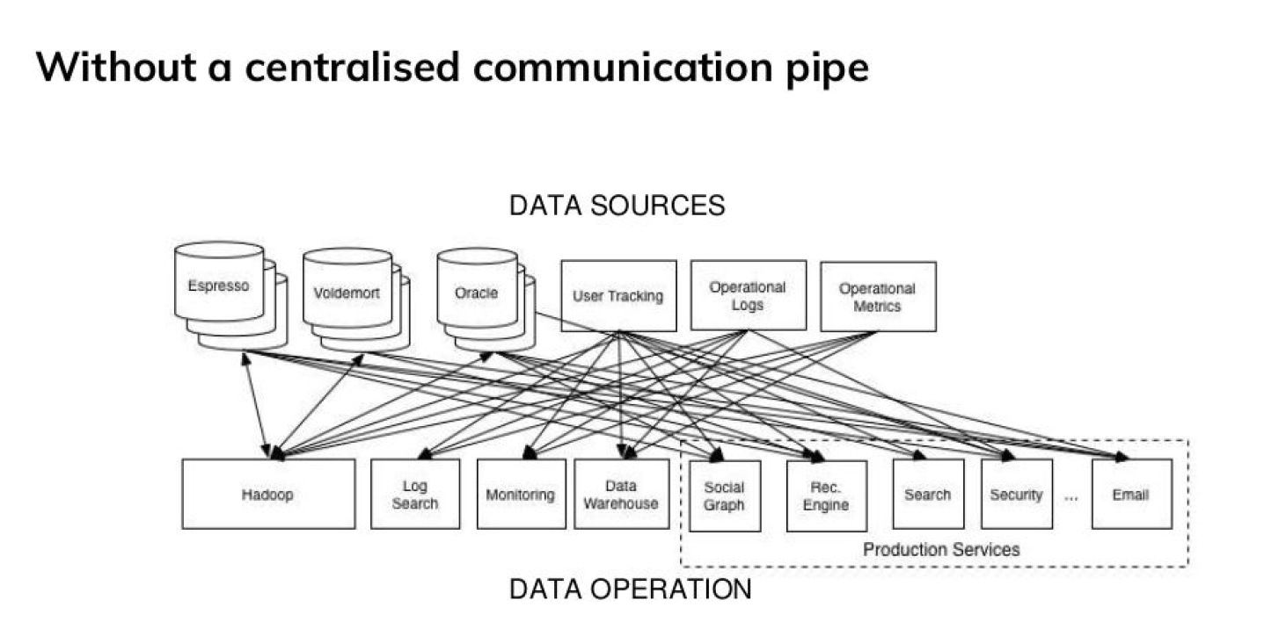
Why Kafka?

Slide 6
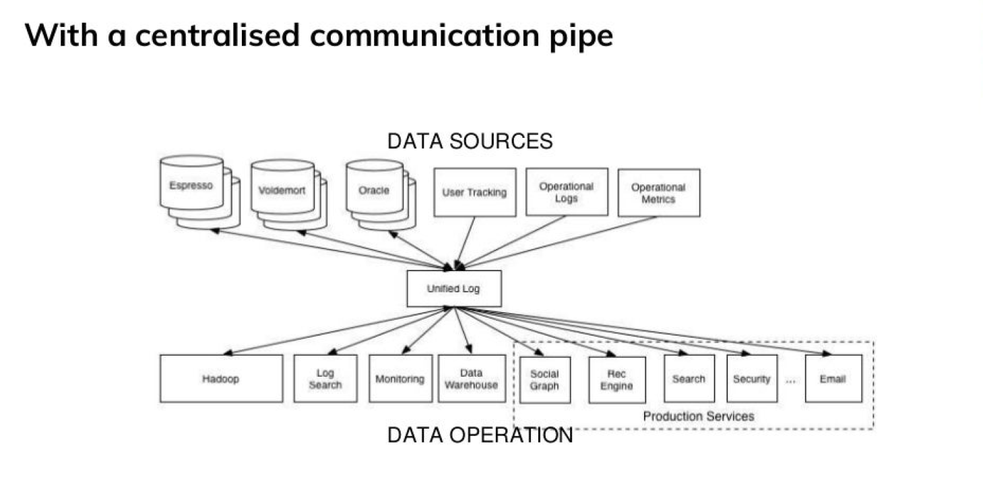
Why Kafka?

Slide 7
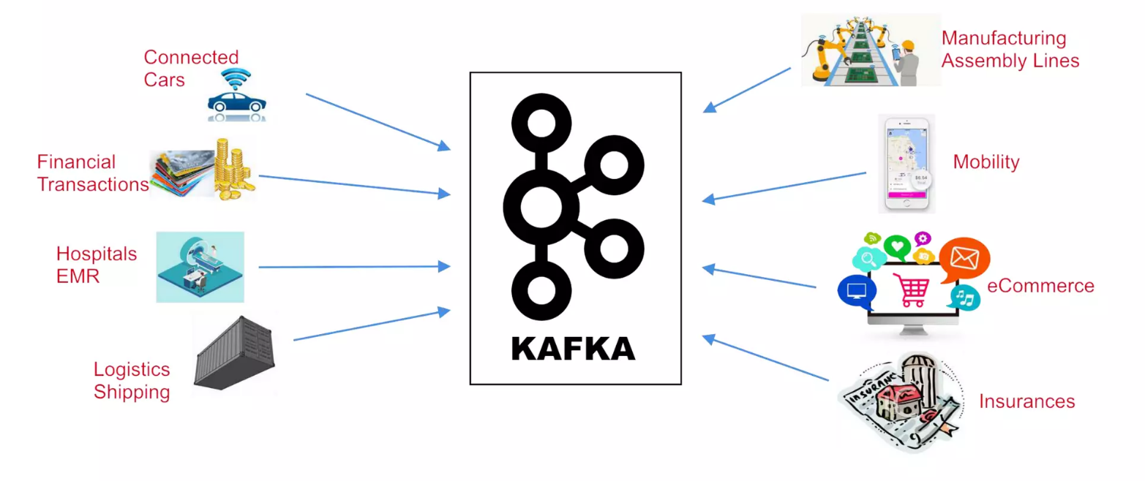
The World Produces Data

Slide 8
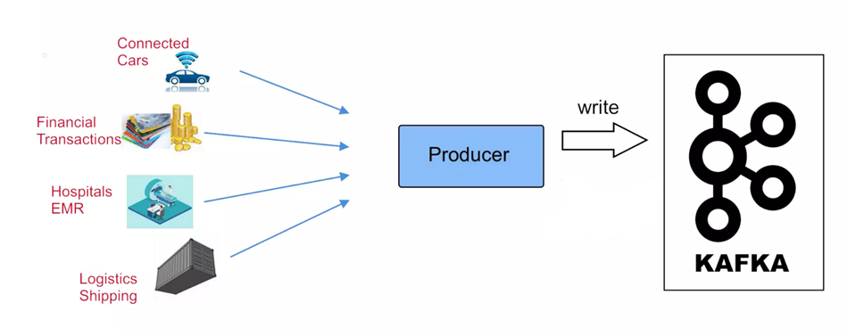
Producers

Slide 9
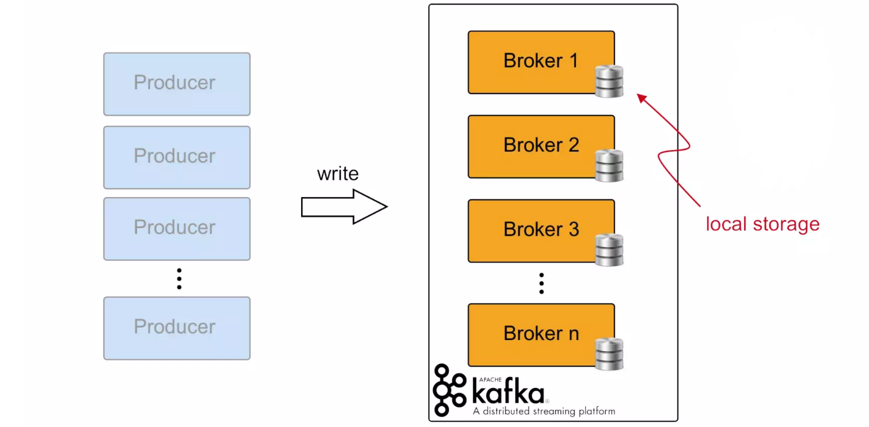
Kafka Brokers

Slide 10
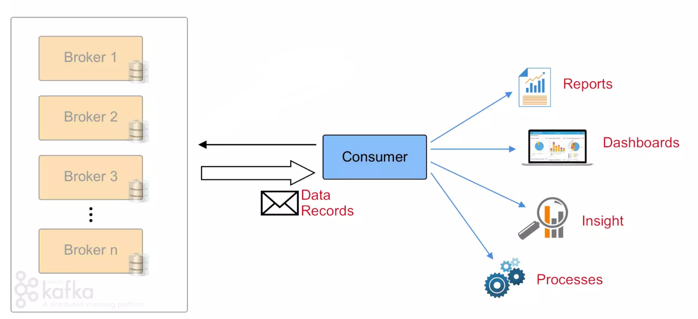
Consumers

Slide 11
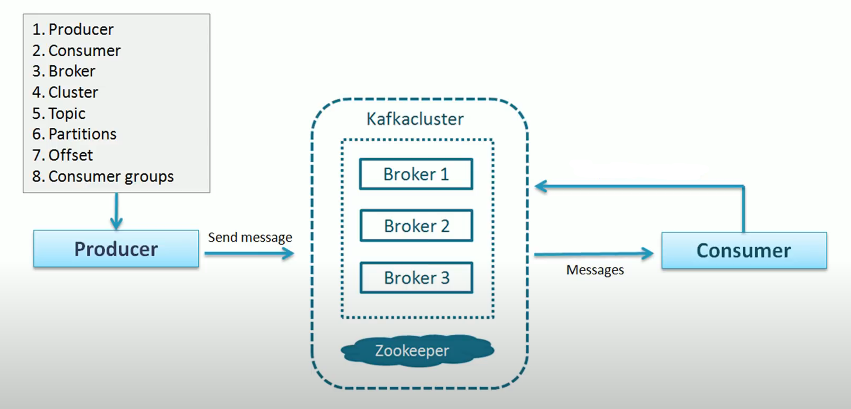
Kafka Architecture

Slide 12
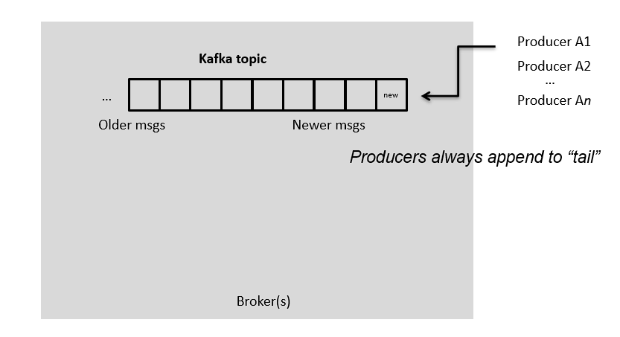
Topics

Slide 13
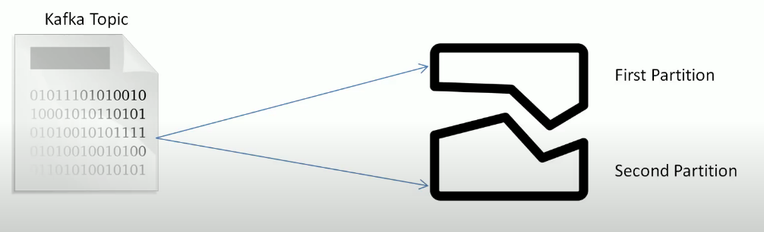
Partitions

Slide 14
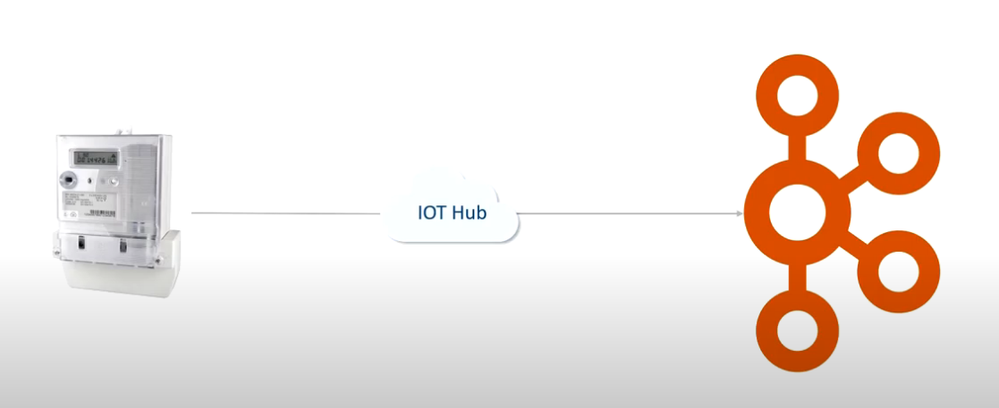
Kafka Streaming

Slide 15
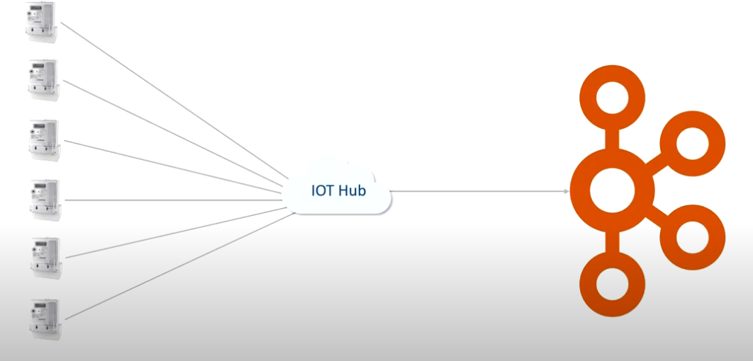
Kafka Streaming

Slide 16
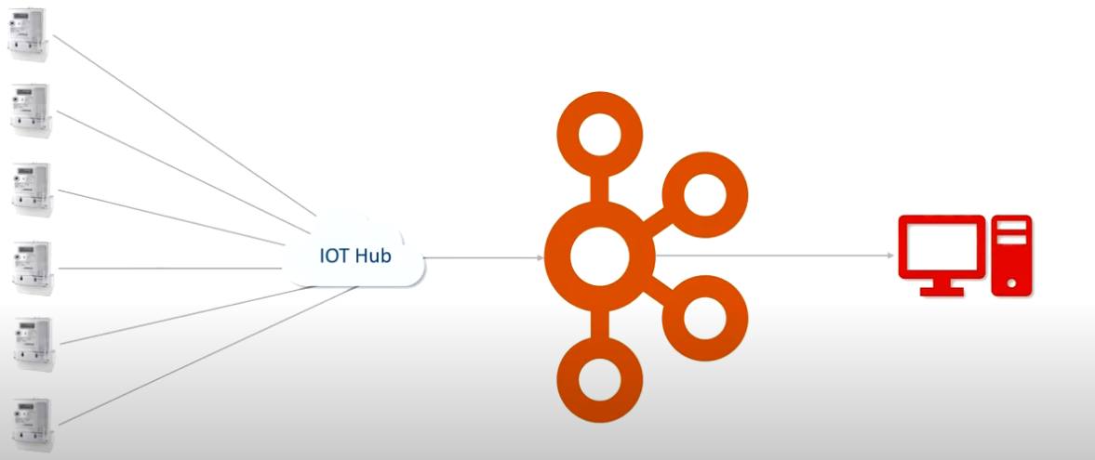
Kafka Streaming

Slide 17
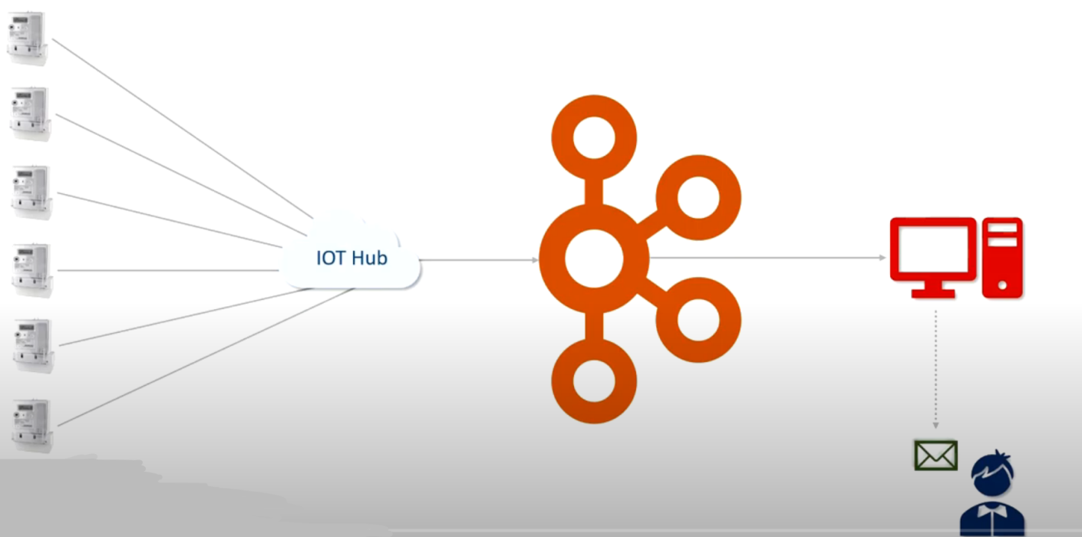
Kafka Streaming

Slide 18
Kafka Advantages
Low Latency
High Throughput
Fault Tolerance
Scalability
Open Source

Slide 19
Companies that use Kafka
More than 80% of all Fortune 100 companies trust, and use Kafka.
Uber – Gather a user, taxi, and trip data in real-time to compute and forecast demand and compute surge pricing in real-time
LinkedIn – Prevents spam and collects user interactions to make better connection recommendations in real-time
Twitter
Spotify
Airbnb, and many more.

Slide 20
Kafka QuickStart
Download Kafka, creating a console-based consumer/producer.
Requires ZooKeeper to be installed and running.
Create a topic as required by the project.
Create a project with the required dependencies.

